Slide 1
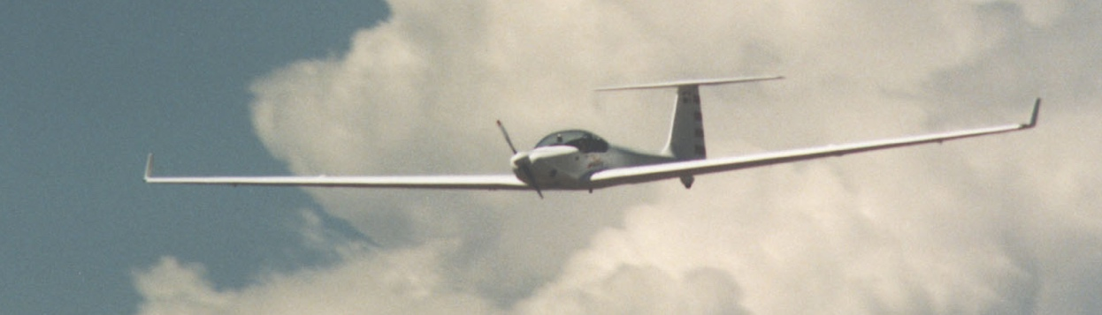
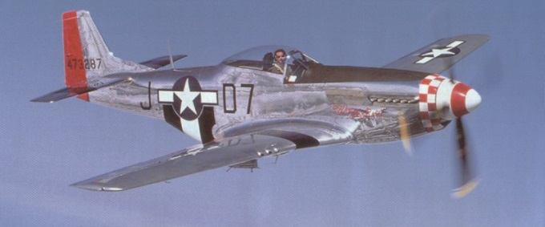
Introduction to Aviation
Young Eagles Program
EAA Chapter 301
Coordinator: Blanche Cohen

Slide 2
This Evening's Topics
For the Parents
YE Registration Form
Directions to Front Range Airport
What is EAA?
What is the Young Eagles program?
What’s in it for you?
The EAA Flight Plan
Some Safety Stuff!
Notes:
Parents – please stay for this first part. Then you can leave if you'd like but please return by 9 pm. I'm not driving anyone home!
We've got a LOT to go thru tonight - questions only. Comments after we cover all the material.

Slide 3
Registration
Online registration at yeday.org
Your coordinator will provide the exact link because you will NOT find it online
If not using online registration, fill out the paper form:
Only the top of Side 1
Sign Side 2

Slide 4
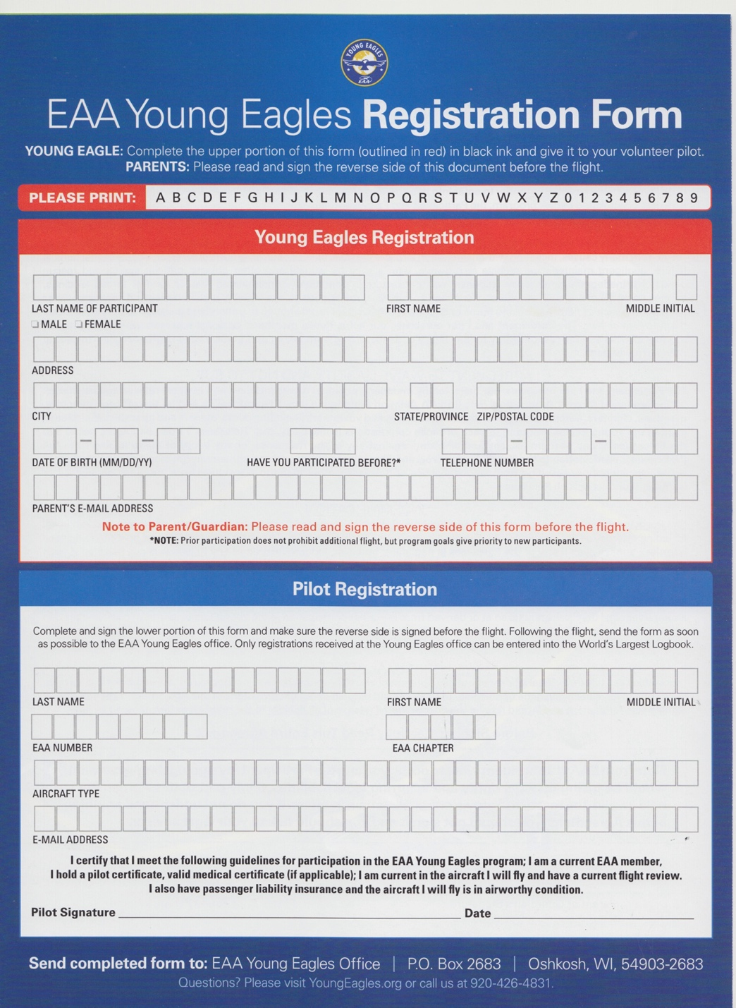
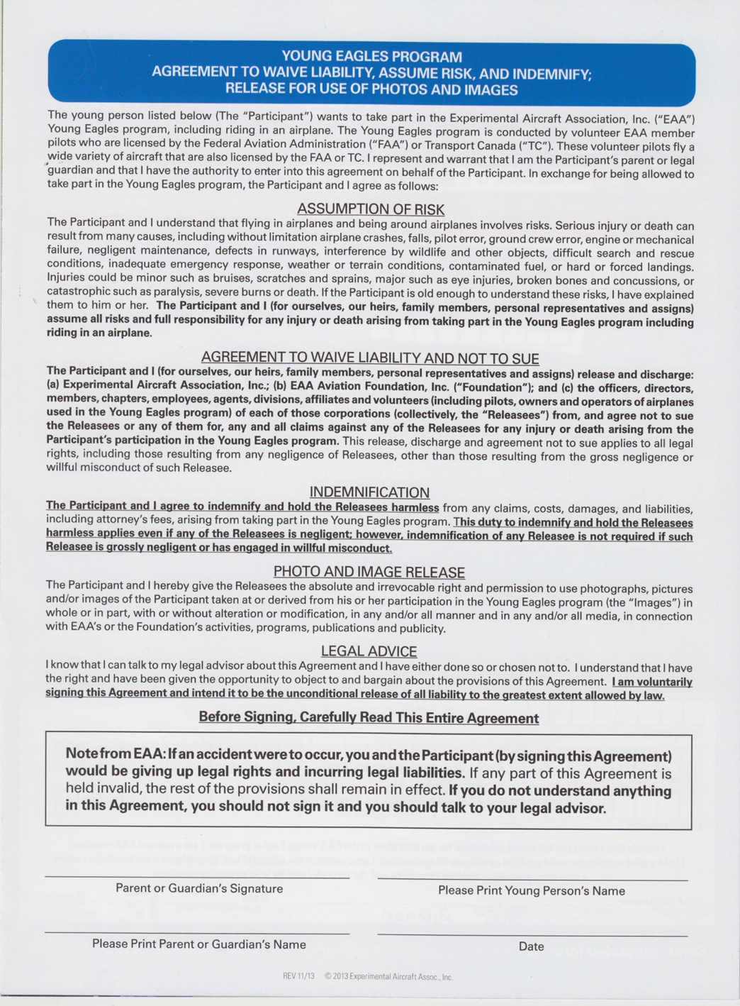
Notes:
Fill out the TOP only. Do NOT fill out the bottom - that's for us.
Any attorneys in the room? Once upon a time the form was two lines:
"flying can be dangerous, you fly at your own risk".
Then the lawyers got involved and it's become a Supreme Court case!
Reverse of the form - Parent or Guardian MUST print your name & sign. We always have extras at the airport but if no Parent or Guardian is there to sign, no flying.
One page - do NOT copy this form onto 2 pages and staple together. It will be tossed and the YE will NOT fly!

Slide 5
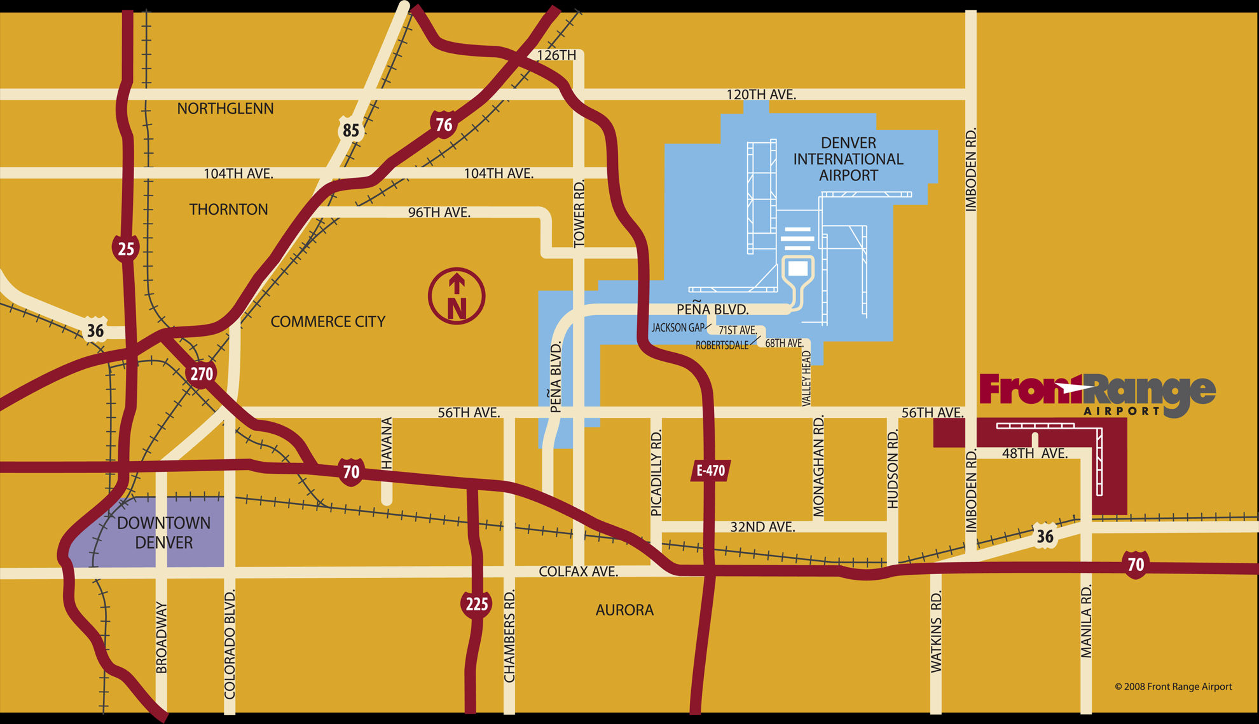
Getting to Front Range...er...that other name....

Slide 6
Ok, so the name changed....
Front Range Airport is now...
Colorado Air & Space Port
But it'll always be Front Range to us
Both names are being used, depending what/where you find the info.

Slide 7
Directions to Colorado Air & Space Port
(the airport formerly known as Front Range):
I-70 east to exit 295 (unless you live east of Watkins)
Exit north
go right on Colfax
go left on Imboden road
go right on 48th
go left on Front Range Parkway
go right at the Terminal drive
park there
walk to building due east: 2 signs "Front Range Flight" & "EAA 301 Young Eagles"
go to the EAA 301 banner & door (north side)
Address: 5200 Front Range Pkway
Notes:
How long does it take? FTG is further south than DIA but further east. So however long it takes you to drive to DIA, about the same to FTG
Anyone live east of Watkins?
Different directions:
West on I-70 to exit 299, Manila Rd. Turn north on Manila, across Colfax, across the Railroad tracks. The N-S runway will be on your right. Keep going (about 3 miles) to 48th Ave. There's no street sign, but it's the only left turn possible. You'll see the ATC Tower. Continue west to Front Range Parkway. Big sign!
Turn right, go to the end. On the left is a Colorado Natl Guard base. Keep going. At the end is the Terminal on the right (flag pole).
There are 3 buildings – the terminal, the Executive Hangar (beige) and a big blue hangar, named Big Blue. Park in the lot just south of the Exec Hangar. We're in the north side of the Exec Hangar – look for the EAA YE sign.
Park on the south side of the Exec terminal, walk up the west side, look for EAA YE Sign and enter the west side door.
DO NOT WALK ON THE RAMP!!!

Slide 8
Security
The airport has installed fencing.
Park in the area in green
If the fences are completely built,
walk thru the office,
make an immediate right turn,
go to the hangar just east of the office,
enter at the red line.
Look for EAA301 Young Eagle signs
Notes:
How long does it take? FTG is further south than DIA but further east. So however long it takes you to drive to DIA, about the same to FTG
Anyone live east of Watkins?
Different directions:
West on I-70 to exit 299, Manila Rd. Turn north on Manila, across Colfax, across the Railroad tracks. The N-S runway will be on your right. Keep going (about 3 miles) to 48th Ave. There's no street sign, but it's the only left turn possible. You'll see the ATC Tower. Continue west to Front Range Parkway. Big sign!
Turn right, go to the end. On the left is a Colorado Natl Guard base. Keep going. At the end is the Terminal on the right (flag pole).
There are 3 buildings – the terminal, the Executive Hangar (beige) and a big blue hangar, named Big Blue. Park in the lot just south of the Exec Hangar. We're in the north side of the Exec Hangar – look for the EAA YE sign.
Park on the south side of the Exec terminal, walk up the west side, look for EAA YE Sign and enter the west side door.
DO NOT WALK ON THE RAMP!!!

Slide 9
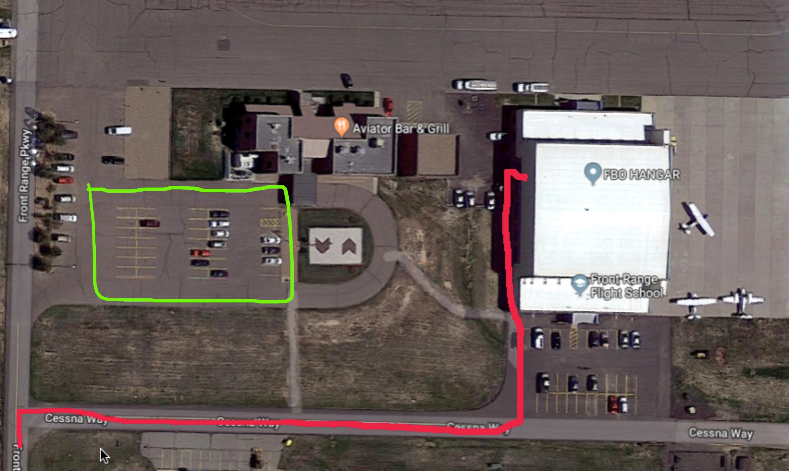

Slide 10
Weather
It's going to be chilly then really warm
Wear layers!
Sunglasses & Sunblock!
We only fly in nice weather
Light winds are ok – high winds are not!
Mother Nature doesn't always cooperate
If we need to cancel, I'll call the coordinator of your group
Sometimes, it just happens.

Slide 11
Thank you Parents, You're Excused
Please return no later than 9 pm.

Slide 12
Definition of Airplane
So? What counts as an Airplane?

Slide 13
Definition of Airplane
A vehicle heavier than air, kept aloft by the lift generated by the passing of air over & under the fixed wings.
And/or driven by propeller, jet propulsion or any similar heavier than air vehicle such as a glider or helicopter.
But not a balloon.
Or a rocket.
Notes:
Parents – please stay for this first part. Then you can leave if you'd like but please return by 9 pm. I'm not driving anyone home!

Slide 14
Why fly an Airplane?
How many of you have flown in an Airplane?
Commercial –vs- General Aviation?
Notes:
How to introduce people to aviation? Take them for a ride!
Commercial flight – like riding in a Greyhound bus.
GA Flight – like driving a Ferrari!

Slide 15
What is EAA?
EAA=Experimental Aircraft Association
Founded in 1953
More than 170,000 members world wide
“EAA’s roots are with those that built and restored their own airplanes, but in its few years EAA quickly became an organization that was inviting to all aviation enthusiasts.”
Paul Poberezny – Founder and Chairman of the Board, EAA
Notes:
This an an international organization, not just the US.
Global organization, chapters all over the world - members in Antarctica but no chapter yet.
We have people who built their airplanes, bought factory airplanes, and people who don't fly, just love aviation.

Slide 16
What is Young Eagles?
The EAA Young Eagles Program launched in 1992,
Developed to welcome young people into the world of aviation.
Original Goal – Fly 1M by 2003
100th anniversary of powered flight
Over 2.3 Million today!
EAA 301 has flown over 7300!

Slide 17
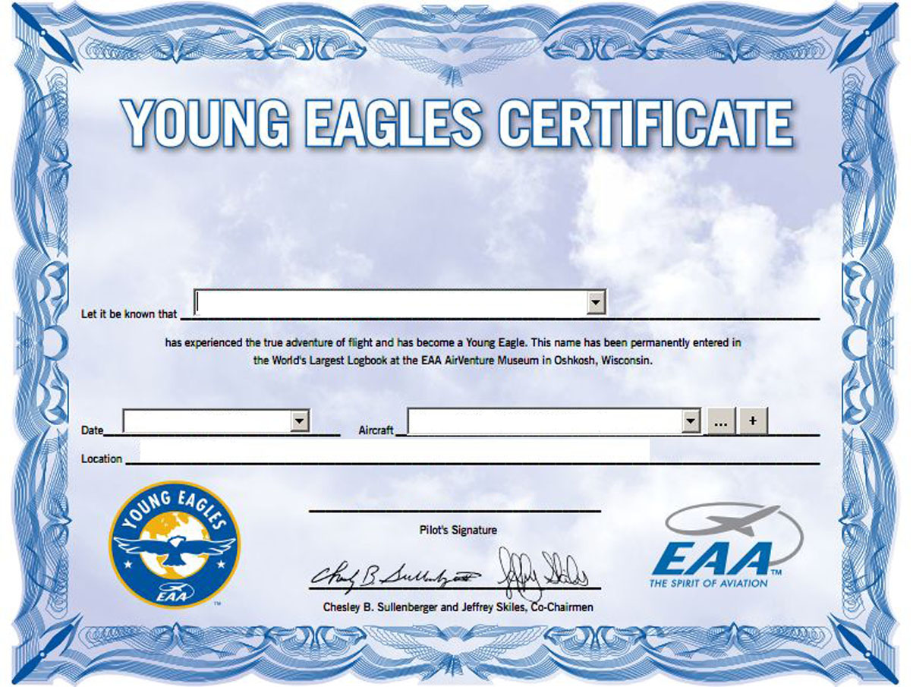
For You – YE Certificate

Slide 18
Second - Registration
Registration in the World's largest logbook
Visit the EAA Museum in Oshkosh, WI and look in the book for your name, or
Go to the EAA Young Eagles website and search for your name.
eaa.youngeagles.org

Slide 19
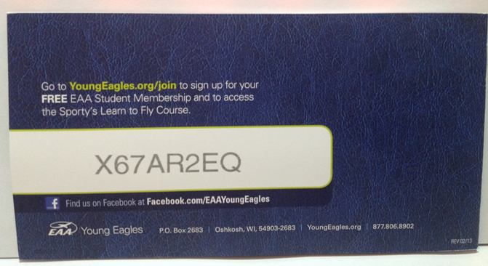
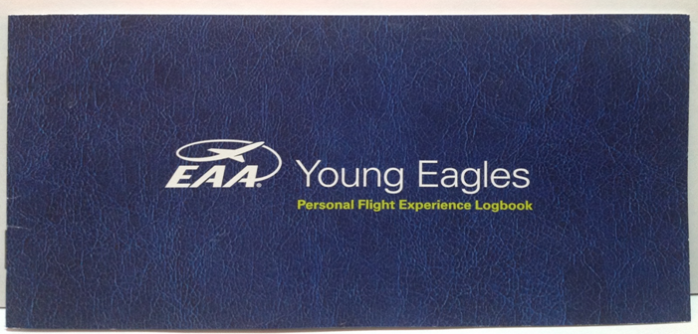
Third – Sporty’s Log book
Sporty’s Log Book & Online Pilot Training & Access Code
Recommended for ages 13 and older
Notes:
Part of learning to fly is going to school - ground school. After learning about weather, rules of flying, how airplanes work, navigation, you'll take an exam. You can learn 3 ways:
go to a class with an instructor
study the books by yourself or with friends
take a course online - part of your YE event today is your logbook.
Sporty's provides the logbooks for all YEs and on the back is a magic code for you to take the online course.

